Slide 1

Enhancing Streaming Recommendations Using NLP
Abby Godsen, Jose Contreras, Alvin Hampton & Regan Fleetwood

Slide 2

Table of Contents
1
1. Introduce the Problem
5. Project Pt. 4: Function
2. Project Pt 1: Data Cleaning
6. Demonstration
2
3. Project Pt 2: Sentiment/Genre
7. Results
4. Project Pt. 3: TF-IDF and Cosine Similarity
8. Limitations and Future Works

Slide 3

Introduce the Problem
Cold Start problem occurs in the online streaming services when a new or less active user has no or scarce viewing history.
Classic memory based CF approach fails due to sparse matrix of user-item interactions leading to generic or popularity based recommendations only.
Users in majority can usually mention at least one show they like, current solutions do not know how to make use of this information.
Need for a transparent, fast and content-based recommendation system that would be able to give personalization out of the gate, from the first session.
Our project provides solution by recommending similar anime titles using NLP techniques (TF-IDF, sentiment analysis, genre matching).

Slide 4

Sentiment Analysis and Genre Similarity
Utilizing a MultiLabelBinarizer, the genre was encoded to be more easily comparable and to make it easier to create a combined score.
Sentiment scores were created using a Sentiment Intensity Analyzer. The genre score and sentiment scores were combined into a single feature, then normalized.
Finally, columns were added to the dataset for the genre score, sentiment score, and the final combined score values for easier comparison.
Combined scores are a combination of a 0-1 value for sentiment and a whole number value for genre.

Slide 5

TF-IDF and Cosine Similarity
TF-IDF vectorization was done on the synopsis column of our cleaned dataset to get what each anime is about for further analysis.
Numerical columns like ratings, sentiment, and episodes were then scaled to be in a similar range as the TF-IDF matrix. This was done to help ensure that all features would help contribute more evenly to the final similarity calculation.
These scaled numerical features were combined with the TF-IDF matrix to form a single matrix that factors in not only the synopsis of each anime, but also its rating, number of episodes, and sentiment. As a way to get a more in-depth recommendation.
Cosine similarity was performed on the new combined matrix to create a similarity matrix displaying how similar each anime is to one another.

Slide 6

THE FUNCTION pt1: (Cover Art Fetch)
Arguments: dataframe, anime title, new column title, wait time
Dual API approach: first api attempts to collect as many anime images as possible and if any are not found the second API then tries
Rapidfuzz is used for matching purposes to help search for anime titles within the API
Wait time is used between searches to prevent API request limits being reached
Returns the given dataframe with the new column populated by image urls of each anime within the dataset

Slide 7

THE FUNCTION pt2: (Game Recommendation)
User inputs an anime title and the function searches for title within the data (designed to be case insensitive)
Checks if the provided title exists in the dataset. If not, it returns an error message.
If exists, it will get the similarity score of each anime title within the cosine similarity matrix
The similarity scores are then sorted in order, related to the specific title and the 3 most similar anime titles and similarity scores are then displayed along with the cover art of each anime

Slide 8
Demonstration

Slide 9
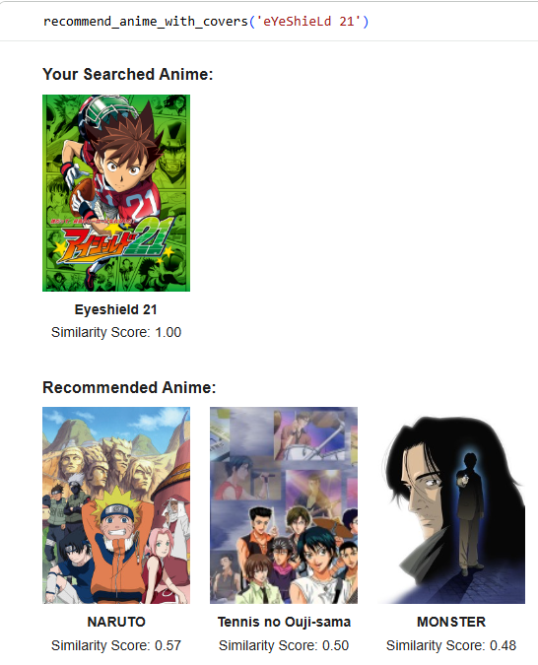
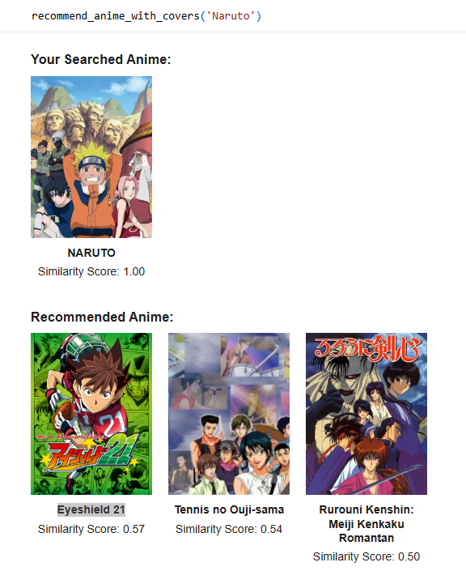
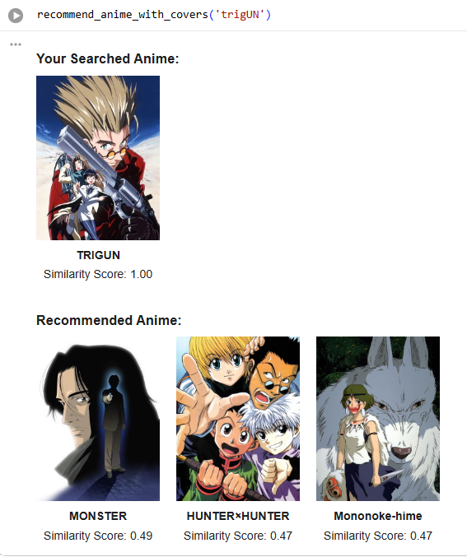
Results

Slide 10

Limitations/Future Work
Limitations
Limited by the animes that are currently in the dataset
User inputs are also limited by what is currently available in the dataset
Limited in functionality because users already need to have an anime in mind to generate similar results. e.g. users couldn’t get recommendations for “action animes”.
Future Work
Using a similar method, this code could be reused in a variety for a variety of other mediums like movies or books as long as the naming conventions were maintained across datasets.

